Slide 1

Oakwood Adventist Academy Building
INFORMATION TECHNOLOGY WIRING SPECIFICATION

Slide 2








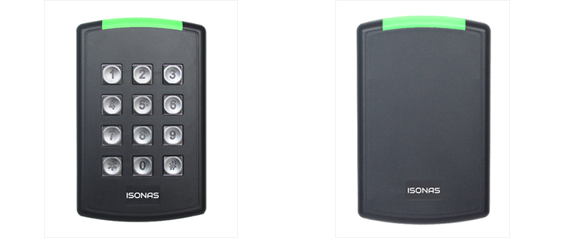





Iconography
Ceiling ->
Wire location Color Coding:
Interior Wall ->
Floor ->
VOIP
Optical Fiber
Wifi Access Points
Card Readers
PA Speakers
VTC Components
Video Cameras

Slide 3
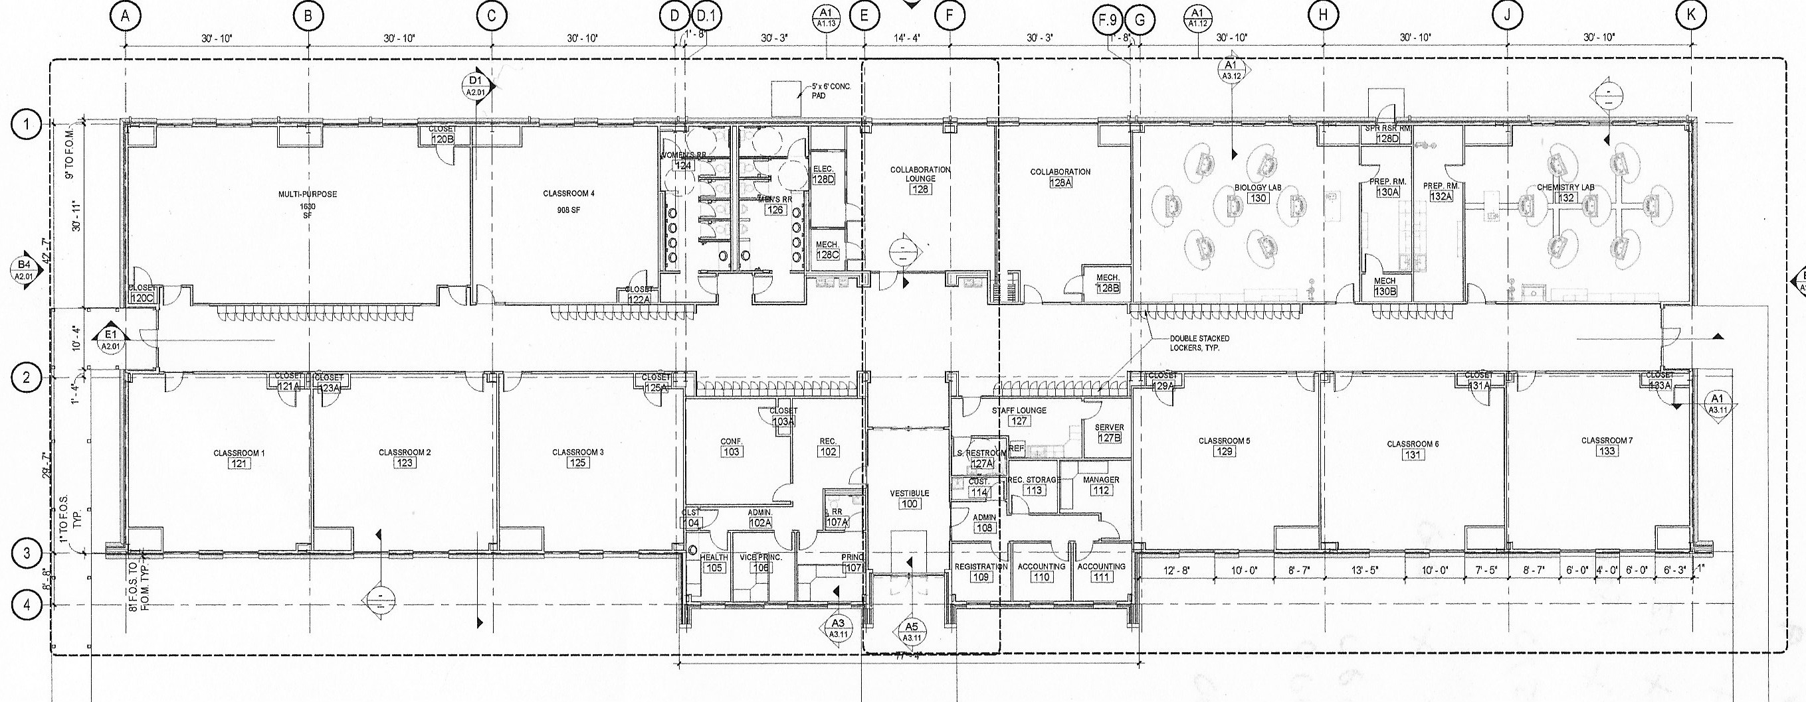

























VOIP

Slide 4
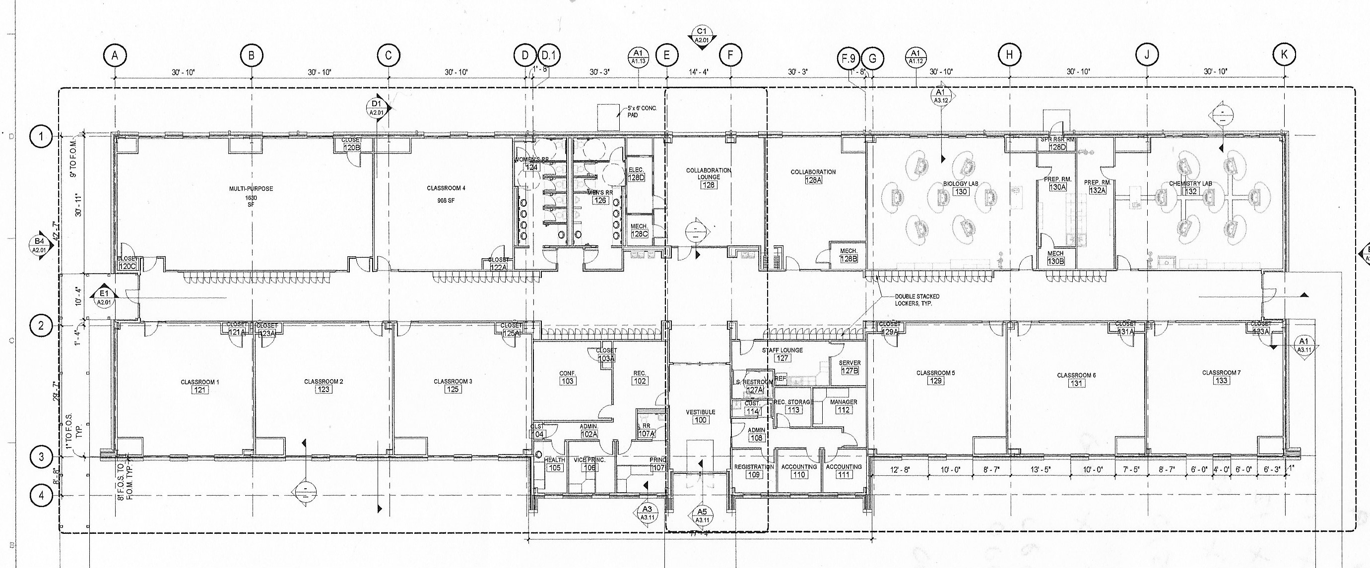








WiFi Access Points

Slide 5












Internodal Fiber

Slide 6


Internodal Cat6

Slide 7





























Video Surveillance

Slide 8
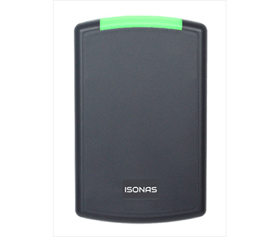
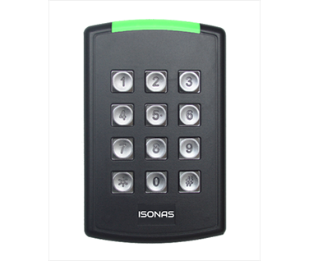
Access Control
24vdc
24vdc
120vac/24vdc

Slide 9

Digital Signage

Slide 10

Video Conferencing

Slide 11
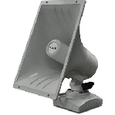
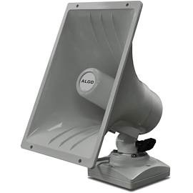























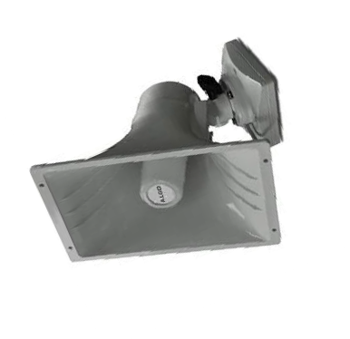
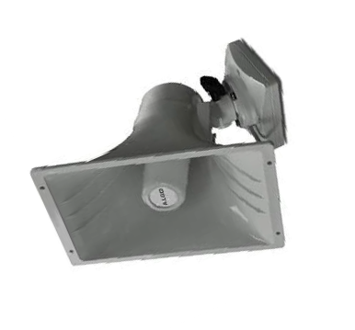


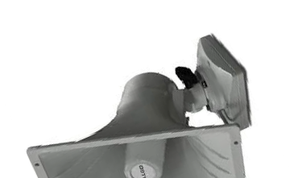



PA & Intercom

Slide 12

Television Monitors

Slide 13
Wiring Summary
Category | # of Drops Required | Comments
Access Control | 31 | 2 120vac, 2 24vdc
Digital Signage | 16
Internodal Fiber | 12 | Multimode Fiber NIC
Internodal Cat6 | 84
PA/Telecom/Paging | 31
Television Monitors | 33 | RG6/HDMI/Ethernet
Video Conferencing | 24
Video Surveillance | 27
VOIP | 25
Wifi Access Points | 14

Slide 14






Providers
Internetworking
WOW
Network Switches
ADTRAN
VOIP
FreePBX Digium Sangoma

Slide 15






Providers
PA Intercom
Cyberdata
Video Surveillance
Hanwha Technologies Wisenet
Access Control
ISONAS
Securitron Assa Abloy

Slide 16




Providers
Video Conferencing
Zoom Technologies
Digital Signage
Visix xAxis
Internodal Fiber
CTIS

Slide 17
Providers
Internodal Cat6
Thomas Electric
Internodal Fiber
CTIS
Wifi
Ubiquiti

Slide 18




Consultants
VOIP
Crosstalk Solutions
Internodal Fiber
Grraybar CTIS
Digital Signage
Visix International

